Slide 1
Assignment 4
Presentation subtitle

Slide 2
2024
Insight and Recommendations
Sahar Shariatpanahi
What the analysis answers:
Identifies patterns, trends, or anomalies
How do sales change by month and quarter?
Suggests a cause or explanation
Points toward a potential action

Slide 3
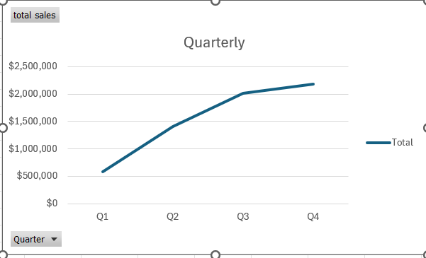
Identify the patterns, trends, and anomalies
Trend:
By looking at the Quarterly char, the conclusion is as follows:
Insight
Sales strengthens substantially later in the year. Sales increases from Q1 through Q4 with Q4 producing the highest value.
Implication:
Inventory may need to be increased before Q3 –Q4 period to meet the demand

Slide 4
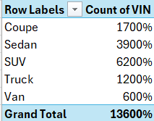
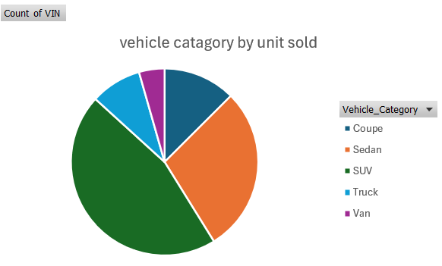
Identify the patterns, trends, and anomalies
Patterns:
Insight:
SUVs are the strongest over all category based on the sales volume
Sedans are the second strongest
Van occupies the lowest volume

Slide 5
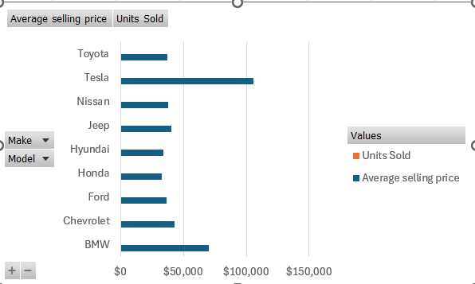
Identify the patterns, trends, and anomalies
The make analysis shows :
Volume leaders:
Honda, Toyota, Nissan, and Hyundai are tied at 17 units each. Ford and Chevrolet follow closely at 16.
Make-level volume is useful for inventory planning. Model-level rankings should be treated cautiously because the sample is highly dispersed across many models

Slide 6
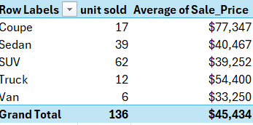
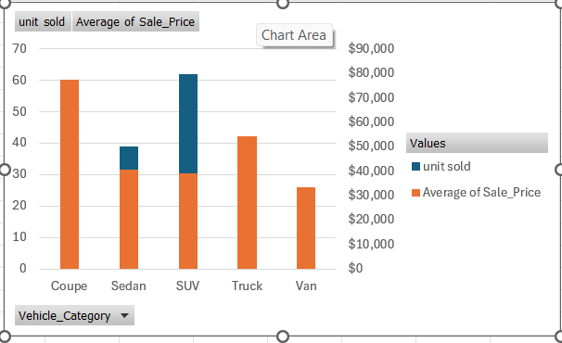
Price vs. Sales Volume by Vehicle Type
Volume and price do not move together. SUVs lead unit's demand
while Coupe has the highest average price.

Slide 7
Business Recommendation
Inventory
Prioritize SUV availability; keep Van inventory lean and demand-driven. 62 SUV unit's vs 6 van units.
Pricing
Protect margins on Coupes and high-value Tesla models Coupe avg. $77.3K; Tesla avg. $105.5K
.
Pricing
Build inventory and campaign capacity before Q3; use premium-oriented offers in Q4
Pricing
Use Make and category trends for decisions until more model-level history is collected.

Slide 8
2024
Spot patterns across vehicle categories
Sahar Shariatpanahi
What the analysis answers:
Are certain vehicle types (SUVs, sedans, electric vehicles) growing faster?
Is there a shift in consumer preferences for certain fuel types?
Do sales of certain vehicle categories correlate with specific seasons or economic indicators?
Are premium models performing differently than economy models?

Slide 9
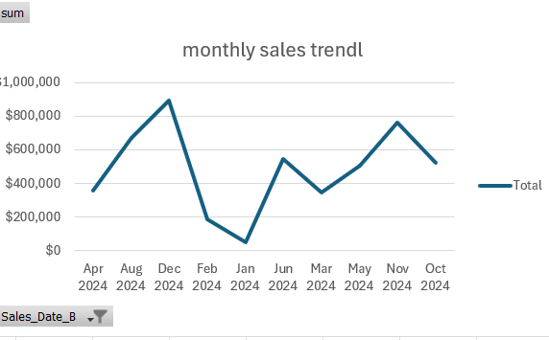
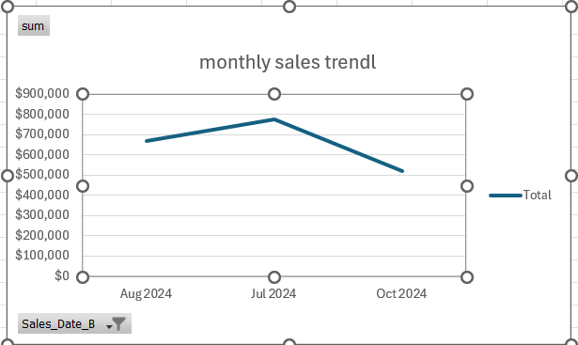
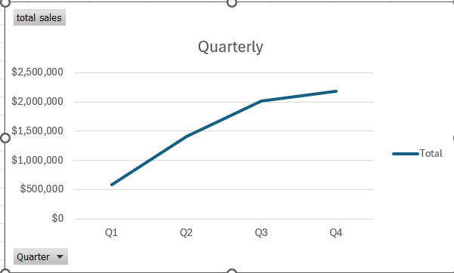
Car Sales seasonal patterns
After Filtering the pivot chart in the excel file. (monthly_sale _trend) and quarterly chart . There is strong buying activity between Q2 and Q3. The sales pick is in July. Between Q3 and Q4 between October and November the sales is slower.

Slide 10
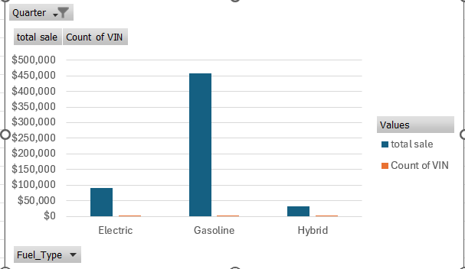
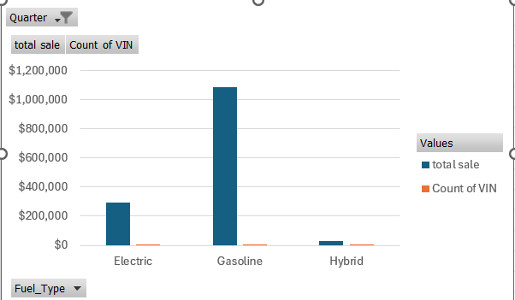
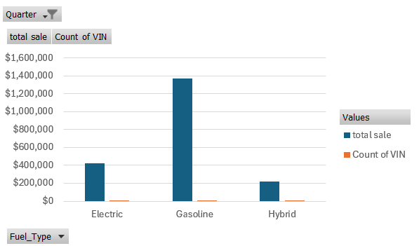
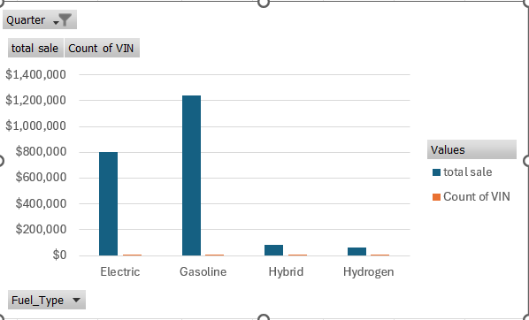
Preference on the fuel type
The data set in fuel type of the excel file (Assignment 4) shows a clear shift toward the electric vehicles in Q4 while Gasoline remains the largest fuel type
Q1
Q2
Q3
Q4

Slide 11
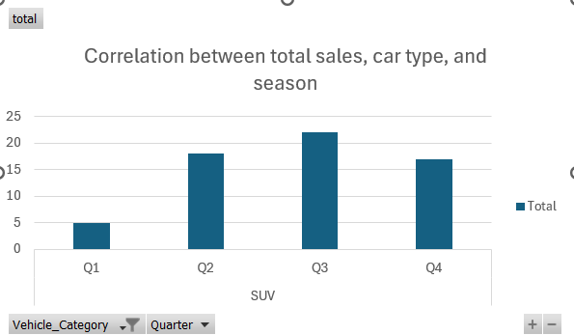
Correlation between sales and season
Please look at the sale_seasonal _pattern in the excel file. There is a pivot chart that shows the correlation between the car type total sale and season
SUV:
Season | Total sale
Q1 | 5
Q2 | 18
Q3 | 22
Q4 | 17

Slide 12
Correlation between sales and season
Please look at the sale_seasonal _pattern in the excel file. There is a pivot chart that shows the correlation between the car type total sale and season.
After filtering the Vehicle category and quarters , the results are as follows:
Vehicle category | Q1 | Q2 | Q3 | Q4 | Pattern
Sedan | 9 | 8 | 11 | 11 | Stable through the year
SUV | 5 | 18 | 22 | 17 | Strongest from Q3-Q4
Coupe | 0 | 3 | 4 | 10 | LAST Quarter concentration
Truk | 2 | 6 | 2 | 2 | Concentrated in Q2
Van | 0 | 0 | 6 | 0 | Sales occurred in Q3

Slide 13
2024
Actionable business recommendations
Sahar Shariatpanahi
What the analysis answers:
Inventory optimization strategies based on sales patterns
Pricing recommendations for specific vehicle segments
Marketing campaign focus areas based on high-potential vehicle categories
Seasonal promotion strategies aligned with buying patterns
Sales team resource allocation based on regional performance

Slide 14
Suggestions
SUV demands are the largest category in the data sheet (please look at vehicle type sheet in the excel file)
Recommendation: Prioritize SUV inventory while maintain a balance
Protect Coupe margin and avoid large amount of discount. Coupe shows a fair amount of sales profit despite the medium number of sold units
Vehicle | Units sold | price
SUV | 62 | $2,433.600
Sedan | 39 | $1,578.200
Coupe | 17 | $1,314.901
Truck | 12 | $652.800
Van | 6 | $199.510

